Slide 1
Josh Parker & Steve Weinhart
Project 1

Slide 2
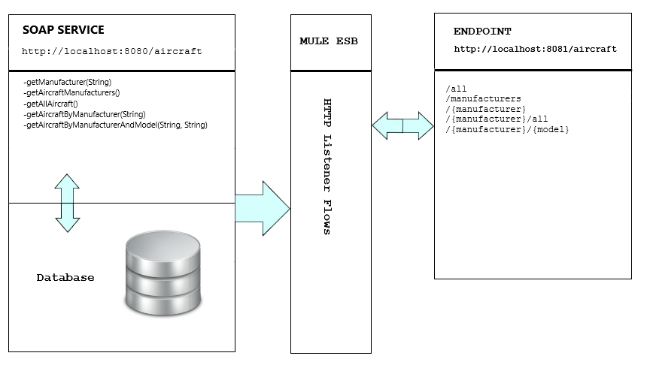
Aircraft Service

Slide 3
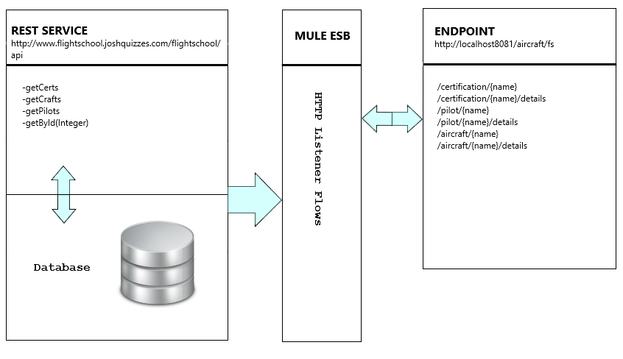
Flight School Service

Slide 4
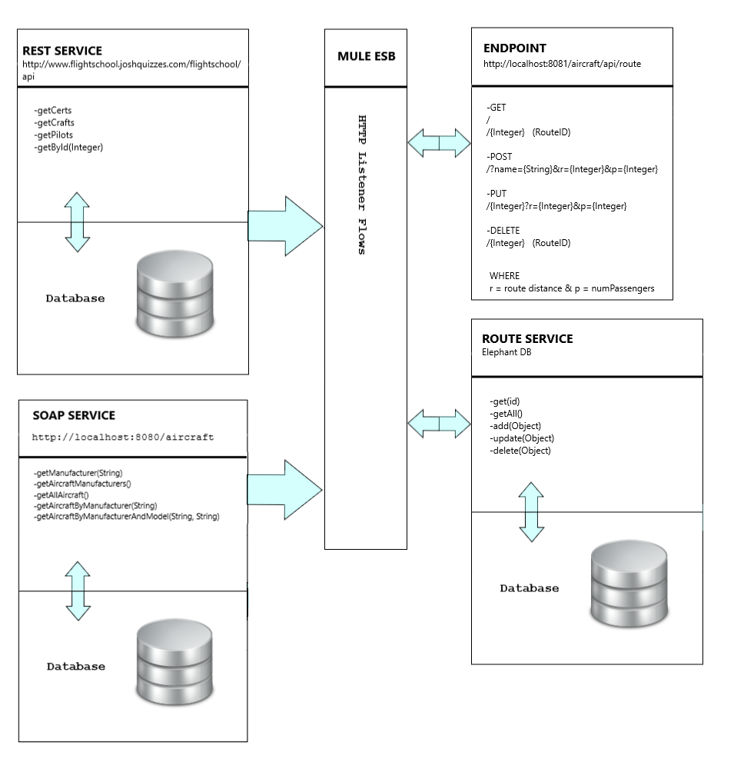
Route Service
Notes:
Route Service Simulates an airline generating and modifying routes.
Routes require a unique Route Name, the requested distance in miles, and requested number of passengers.
Mule uses the getAllAircraft in the SOAP method and selects aircraft that meet range and passenger requirements.
Mule then searches the getPilots REST method for qualified pilots.
Once paired, the route is added to the ROUTE service ElephantDB

